Slide 1

Cyber Threat Detection Algorithm
Understanding data and exploring algorithms

Slide 2
ESP32 Microcontroller Data
PV_Voltage | PV Current | Battery Voltage | Battery Current | SOC | PCC Voltage | PCC Current | Three Phase Voltage | Three Phase Current
14.64 | 0.62 | 13.27 | 0.37 | 100 | 23.61 | 0.14 | 15.05 | 0.02
14.65 | 0.67 | 13.28 | 0.54 | 100 | 23.61 | 0.26 | 15.32 | 0.03
12.78 | 0.57 | 13.29 | 0.31 | 100 | 23.41 | 0.15 | 15.17 | 0.07
12.7 | 0.59 | 13.26 | 0.22 | 100 | 23.46 | 0.07 | 15.03 | -0.05
12.68 | 0.57 | 13.21 | 0.25 | 100 | 23.56 | 0.17 | 14.85 | 0
12.69 | 0.56 | 13.24 | 0.28 | 100 | 23.48 | 0.19 | 14.86 | -0.02
Evaluated data from ESP32 microcontroller on the PV system transmitted via MQTT.
It includes critical PV system parameters for operational performance.
For cyber threat detection current data lacks essential elements like network traffic, packet logs, and authentication attempts needed for identifying security threats.

Slide 3
Enhanced Data for Cyber Threat Detection in PV System Monitoring
Data Ranges:
PV Voltage: 2.18 - 17.63 V
PV Current: 0.07 - 0.83 A
Battery Voltage: 12.97 - 13.4 V
Battery Current: -0.41 - 0.86 A
SOC (State of Charge): 20 - 100%
PCC Voltage: 23.06 - 23.92 V
PCC Current: 0.05 - 0.26 A
Three Phase Voltage: 14.54 - 16.12 V
Three Phase Current: -0.11 - 0.17 A
Additional Columns for Cyber Threat Detection
Timestamp: Date and time for each data point (Range: 2024-02-15 onwards, every minute)
Result Code: HTTP-like status codes (200, 400, 500) with assumed probabilities
MQTT Topic: Topics like pv_voltage, battery_current, etc.
Quality of Service (QoS): MQTT message delivery levels (0, 1, 2)
IP Address: Device IP addresses (192.168.1.100 - 192.168.1.102)
Port: MQTT standard ports (1883, 8883)
Authentication: Type of authentication used (None, Basic, Token)
Data Transmission Frequency: Frequency of data transmission (1Hz, 2Hz, 5Hz)
Packet Size: Size of the transmitted data packets (50 - 1500 bytes)
Sample Data generated for 20,000 rows using these ranges

Slide 4
Designing an IDS for SCADA-Controlled PV Systems
Feature Selection
PV_Voltage
PV_Current
Battery_Voltage
Battery_Current
PCC_Voltage
PCC_Current
Three_Phase_Voltage
Three_Phase_Current
Encoded variables for Mqtt_Topic, ip_address, authentication, and data_transmission_frequency
packet_size
Applied Label Encoding to categorical variables (Mqtt_Topic, ip_address, authentication, data_transmission_frequency) for model compatibility.
Data Normalization: Standardized features using StandardScaler to ensure uniform scale for model input.
It will convert into (-1 to 1)
z=(x−μ)/ σ
z is the standardized value.
x is the original value of the feature.
μ is the mean of the feature values.
σ is the standard deviation of the feature values.

Slide 5
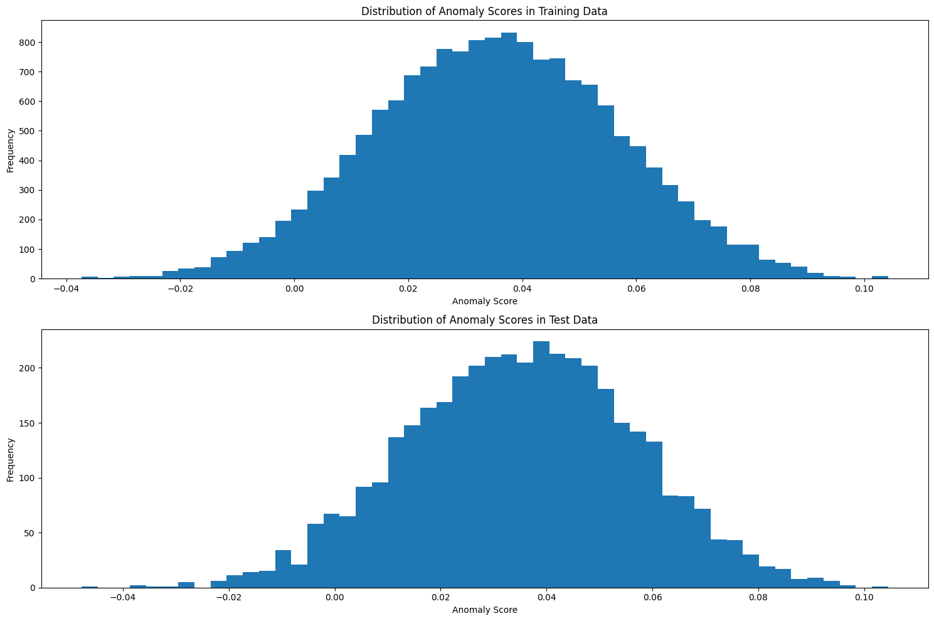
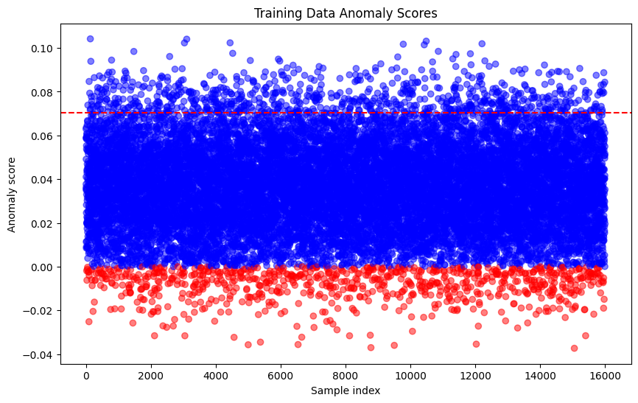
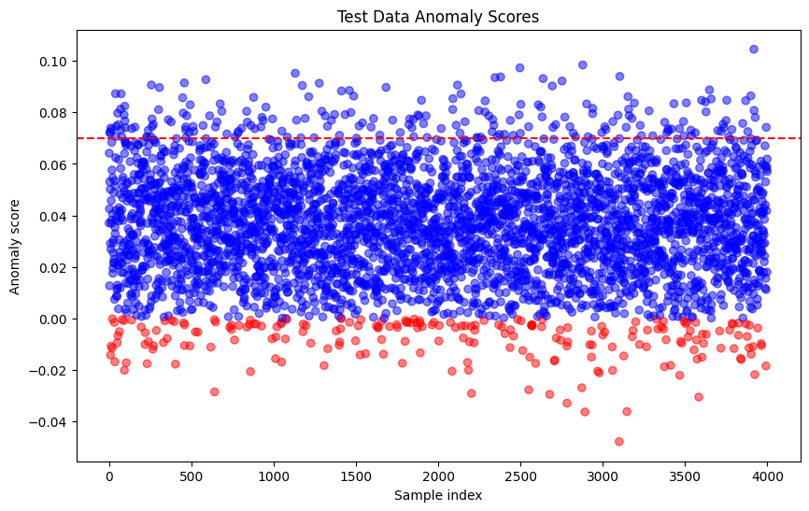
Isolation Forest Algorithm
Isolation Forest model - 200 estimators and a contamination level set to 5%, aiming to isolate anomalies effectively with 80 % training and 20 % testing
Histogram
Both training and testing - scores -0.01 and 0.03
Peak is slightly shifted to the right in test
fewer instances in the extremes – outliers
Scatter Plot
Blue dots -normal data points.
Red dots -anomalies based on a threshold (dashed red line).
The threshold is set slightly above 0.06, which is used to classify anomalies.

Slide 6
Autoencoders
Input layer (input_9): Accepts 13 features with 0 trainable parameters.
First Dense layer (dense_40): A fully connected layer with 150 neurons, uses the tanh activation function. It has 2,100 parameters, calculated as (13 input features * 150 neurons) + (150 biases).
First Dropout layer (dropout_32): A dropout layer with a dropout rate of 0.2 to prevent overfitting.
Second Dense layer (dense_41): Another fully connected layer with 120 neurons, using the relu activation function. It has 18,120 parameters, calculated from the output of the previous dense layer (150 neurons * 120 neurons) + (120 biases).
Second Dropout layer (dropout_33): Similar to the first dropout layer, this one also has a dropout rate of 0.2.
Third Dense layer (dense_42): This layer has 120 neurons with tanh activation function and 14,520 parameters, which comes from (120 neurons from the previous layer * 120 neurons) + (120 biases).
Third Dropout layer (dropout_34): A dropout layer with a dropout rate of 0.2.
Fourth Dense layer (dense_43): A fully connected layer with 100 neurons that uses the tanh activation function. It has 12,100 parameters, calculated as (120 * 100) + 100.
Fourth Dropout layer (dropout_35): Another dropout layer with a rate of 0.2 to help regularize the network.
Output Dense layer (dense_44): The final output layer with 13 neurons (the same as the number of input features) using relu activation function, meant for reconstructing the input. It has 1,313 parameters, from (100 * 13) + 13.
Total Parameters: The model has a total of 48,153 trainable parameters.
It has implemented with batch_size=256, epochs=100, shuffle=True, validation_split=0.2.
Layer (type) | Output Shape | Param #
input_9 (InputLayer) | (None, 13) | 0
dense_40 (Dense) | (None, 150) | 2100
dropout_32 (Dropout) | (None, 150) | 0
dense_41 (Dense) | (None, 120) | 18120
dropout_33 (Dropout) | (None, 120) | 0
dense_42 (Dense) | (None, 120) | 14520
dropout_34 (Dropout) | (None, 120) | 0
dense_43 (Dense) | (None, 100) | 12100
dropout_35 (Dropout) | (None, 100) | 0
dense_44 (Dense) | (None, 13) | 1313
Total params |  | 48153
Trainable params |  | 48153

Slide 7
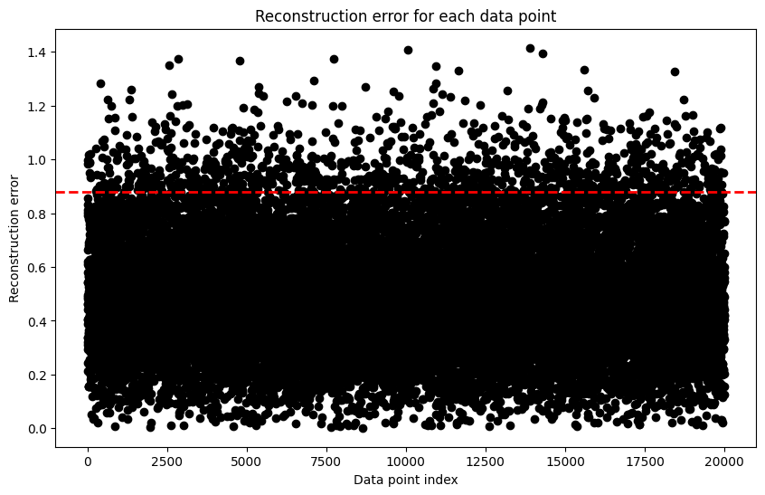
Autoencoders
Reconstruction error for each data point
MSE threshold for anomaly detection: 0.87
Detected anomalies: 1000
Reconstruction error is mostly below 0.2, indicating good model performance for the majority of data.
A threshold at ~0.95 marks potential anomalies.

Slide 8
Next Steps
Adding More Parameters for better performance:
Authentication Logs, System/User Commands, Configuration Changes, other log details.
Trying with Different Algorithms:
Need to Experiment with various advanced unsupervised learning algorithms such as One-Class SVM, Gaussian Mixture Models, and Deep Learning-based approaches (e.g., Variational Autoencoders) for anomaly detection.
Evaluating with Different Metrics:
to assess model performance effectively, Need to Include internal metrics like the Silhouette Score, Davies-Bouldin Index, and Calinski-Harabasz Index for clustering quality assessment.
Code : https://colab.research.google.com/drive/1RDwUn0oiH4LxBDB1cqNu3USZZXEisZsl?usp=sharing

Slide 9
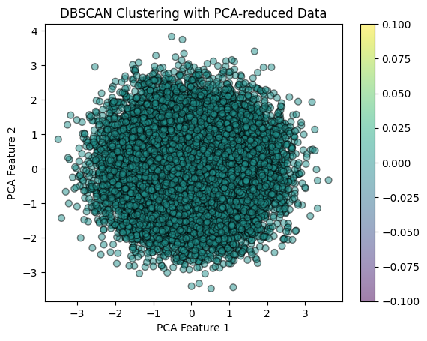
Analysis of DBSCAN Clustering
DBSCAN Implementation:
Parameters Tested: Explored eps range from 2.93 to 3.58 and min_samples from 13 to 25.
Method: Applied DBSCAN across different combinations of eps and min_samples to identify distinct clusters.
Visualization: Employed PCA for dimensionality reduction to visualize clustering outcomes.
Results:
Consistently identified a single large cluster for all parameter combinations.
No noise points detected across all tested parameter settings.
Lack of diversity in clustering results despite varying parameters.
Conclusion:
DBSCAN did not reveal distinct subgroups within the dataset.
The uniformity of clustering results suggests the dataset may not exhibit clear, dense clusters as required by DBSCAN.
eps | min_samples | Number of Clusters | Number of Noise Points
2.932571642200281 | 13 | 1 | 0
2.932571642200281 | 17 | 1 | 0
2.932571642200281 | 21 | 1 | 0
2.932571642200281 | 25 | 1 | 0
3.2584129357780904 | 13 | 1 | 0
3.2584129357780904 | 17 | 1 | 0
3.2584129357780904 | 21 | 1 | 0
3.2584129357780904 | 25 | 1 | 0
3.584254229355899 | 13 | 1 | 0
3.584254229355899 | 17 | 1 | 0
3.584254229355899 | 21 | 1 | 0
3.584254229355899 | 25 | 1 | 0

Slide 10
Variational Autoencoder
Layer (type) | Output Shape | Parameters #
encoder_input (InputLayer) | (None, 13) | 0
encoder (Functional) | [(None, 2), | 9220
 | (None, 2),
 | (None, 2)]
decoder (Functional) | (None, 13) | 8205
dense_6 (Dense) | (None, 512) | 7168
z_log_var (Dense) | (None, 2) | 1026
z_mean (Dense) | (None, 2) | 1026
tf.operators.add (TFOpLambda) | (None, 2) | 0
tf.math.square (TFOpLambda) | (None, 2) | 0
tf.cast (TFOpLambda) | (None, 13) | 0
tf.convert_to_tensor (TFOpLambda) | (None, 13) | 0
tf.math.subtract (TFOpLambda) | (None, 2) | 0
tf.math.exp (TFOpLambda) | (None, 2) | 0
tf.keras.backend.binary_crossentropy (TFOpLambda) | (None, 13) | 0
tf.math.subtract_1 (TFOpLambda) | (None, 2) | 0
tf.math.reduce_mean (TFOpLambda) | (None,) | 0
tf.math.reduce_sum (TFOpLambda) | (None,) | 0
tf.math.multiply (TFOpLambda) | (None,) | 0
tf.math.multiply_1 (TFOpLambda) | (None,) | 0
tf.operators.add_1 (TFOpLambda) | (None,) | 0
tf.math.reduce_mean_1 (TFOpLambda) | () | 0
add_loss (AddLoss) | () | 0
Total parameters: 17425 Trainable parameters: 17425 Non-trainable parameters: 0
Architecture: Utilizes encoder-decoder framework with a sampling layer for dimensionality reduction and latent variable generation.
Components: Features include z_mean, z_log_var mapping in the encoder, and reconstruction in the decoder.
Loss Function: Combines Binary Crossentropy for reconstruction and KL Divergence for regularization.
Training Details: Trained on 13-dimensional data with 50 epochs, batch size 256, and a 20% validation split.
Anomaly Identification: Uses Mean Squared Error (MSE) for anomaly detection; data points with MSE above the 95th percentile threshold are marked as outliers.
Key Takeaways: VAEs are effective for learning data representations and identifying anomalies, crucial for multidimensional datasets.

Slide 11
One Class SVM
Used Same scaled X_train and X_test data for one class SVM
Key Parameters:
Kernel: Radial Basis Function (rbf) for non-linear data separation.
Gamma: 'auto' for automatic selection based on input features.
Nu: Sets the threshold at 0.05, controlling the fraction of outliers and margin size.
Label Assignment:
Translates anomaly scores into interpretable labels from y_pred_train_svm, y_pred_test_svm
'Bad' for anomalies (-1).
'Good' for normal observations (+1).
Applies this labeling both to training and test datasets.

Slide 12
Comparsion of all algorithms
 | Isolation_Forest | One_Class_SVM | Autoencoder | Variational_Autoencoder
Isolation_Forest | 1.000000 | 0.967313 | 0.935375 | 0.959000
One_Class_SVM | 0.967313 | 1.000000 | 0.935312 | 0.972437
Autoencoder | 0.935375 | 0.935312 | 1.000000 | 0.933625
Variational_Autoencoder | 0.959000 | 0.972437 | 0.933625 | 1.000000
Implementation Summary:
Label Preparation: Assign 'Good/Bad' based on model predictions.
Agreement Matrix Initialization: Set up matrix for model comparison scores.
Agreement Calculation: Determine consistency score between model pairs.
Purpose and Insights:
Model Comparison: Assess anomaly detection consistency across models.
Insight Extraction: Uncover similarities or differences in anomaly perceptions.
Methodology Validation: Confirm detection approach robustness through model agreement.
Insights from the Analysis:
Strong Match: The One-Class SVM and Variational Autoencoder agree a lot, meaning they often see the same data points as normal or odd.
General Agreement: All the models mostly agree on what counts as normal or odd, showing they are consistent in their judgments.
Unique Views: Autoencoders sometimes disagree with the other models, which could mean they're picking up on different unusual patterns.

Slide 13
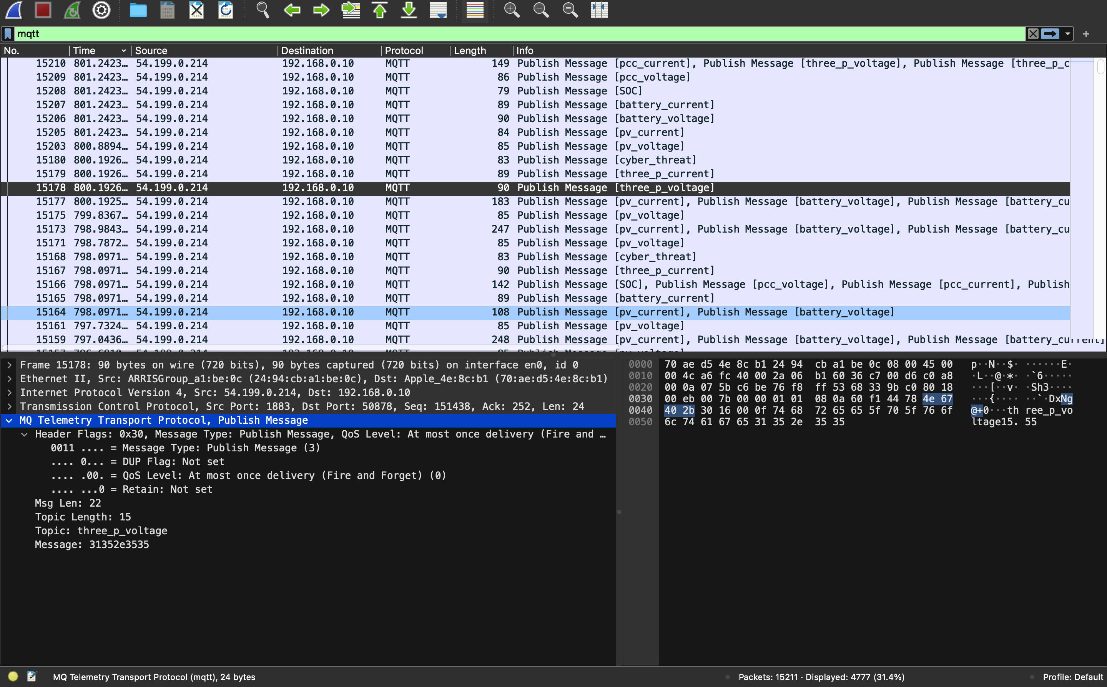
Regarding Data
While running a script provided by Richard for processing MQTT data.
Captured MQTT packets using Wireshark with a filter for MQTT records.
Saved the packet details and plan to extract data using the PyShark library.
Aiming to organize extracted data into a DataFrame with columns: 'Id', 'Protocol', 'Source_IP', 'Destination_IP', 'Length', 'Info', 'Source_Port', 'Destination_Port', 'mqtt_topic', 'mqtt_payload'.
After extraction, will perform data cleaning and scaling.
Intend to remove unnecessary data for clarity and efficiency because it contains inconsistences.
Plan to use the cleaned and scaled dataset for prediction analysis with a developed model.
https://colab.research.google.com/drive/1RDwUn0oiH4LxBDB1cqNu3USZZXEisZsl?usp=sharing

